Slide 1
EZclim a new Software package for Climate modelling diagnostics
By Adanna Akwataghibe
Notes:
Good morning, my name is Adanna Akwataghibe and today I will be talking to you about the new software package for Climate modelling diagnostics EZclim that I developed during this project.

Slide 2

Contents
Ezclim:
Rationale and motivation
Objectives
Development and methodology
Software functionalities
Parallelisation and future work
Conclusions
Notes:
First, I will go into the philosophy and objectives I had when developing EZclim.
I will then talk about how EZclim was developed and its software functionalities.
Finally, I will talk about the parallelisation work we did as well any work that we want to do in the future. Then I will conclude.

Slide 3






Rationale and motivation for a new analysis package
Resolution
Climate models increase
Variables
Numerical experiments
Diagnostics
EZclim
Notes:
Since the first climate model in 1994, there has been an increase in number of climate models and their outputs. There has also been an increase in the number of ensembles (which are variations of the same model), the number and diversity of the climate experiments.
With this technological advancement regarding climate models, there has also been a diversification of the users of these models. Initially, only climate modellers or climate scientists would have the skillset to analyse these models. However, climate models are now more widely available, and they are becoming more popular among users that have limited experience in climate modelling, like businesses, insurance companies, farmers.
So, the need is to bring these climate models together with these diverse set of users.

Slide 4





EZclim: Objectives
Bridge gap between users and climate models
No need to know Python to a high level
Iris, xarray, ESMValTools, NCO, CDO
Single but flexible package
Notes:
With EZclim, as we said before, we want to bring users and climate models together. Climate modellers themselves have more expertise when analysing climate model output – and they use already existing software like Iris, xarray, ESMVALtools, NCO and CDO. However, this software require a good understanding of Python or Unix based commands, netcdf file structure. So, the knowledge threshold is quite high and can limit the kind of users that can analyse the climate models.
So, we want to create a software where the users do not need to know Python or any specific coding language to a high level. EZclim hides the complexity of the functions and analysis of the climate model data underneath a simple user interface.
It’s also a single but versatile package that can ingest other functions not prebuilt in the software.

Slide 5






EZclim: Development
Unit tests
Integration tests
User tests / collaborative
Notes:
When developing EZclim, we used github as our version control – the repository holds the code, user guide and installation requirements.
We synced the continuous integration software Travis with GitHub to run unit tests. These tests were written using the Python pytest framework, to test the individual functions of our code. The integration tests were written to tests that all components of the code worked as expected.
We also engaged with a diverse group of users from non-expert to expert by having one-on-one meetings and developed the program in collaboration with them – to ensure that we developed our software using the agile methodology.
[incremental delivery of functionality: Meetings every week with new or improved functionality
Having one-on-one meetings with the users
Always adding new functionality – never saying no]

Slide 6
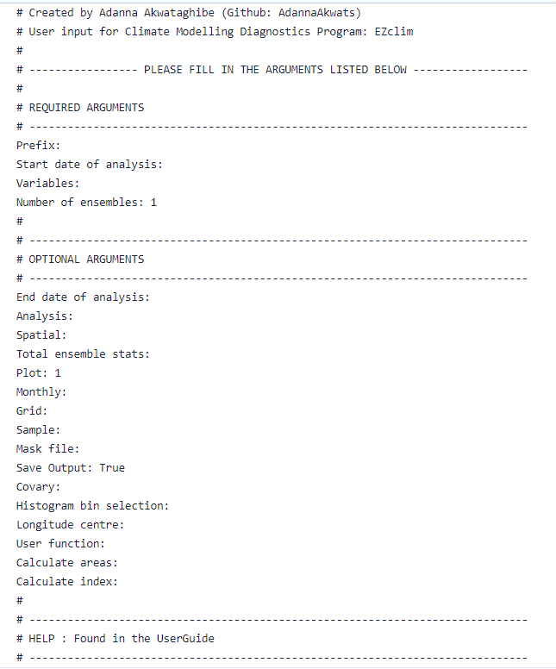
EZclim: High level design
Script
INPUT
EXTRACT
Classes
ANALYSIS
OUTPUT
input.txt
Notes:
The software was split into 4 modular components. The input handles the climate model data given by the user, as well as the user input that can be given in 2 ways: command line and input file, to increase the versatility in terms of usage. The Input file promotes the simplicity of the EZclim interface as the user just has to fill in the blanks.
Extract the 3 main classes deal with extracting the data (given the time period and the variables), analysing or computing the diagnostics of the data and writing the manipulated data to a file.

Slide 7
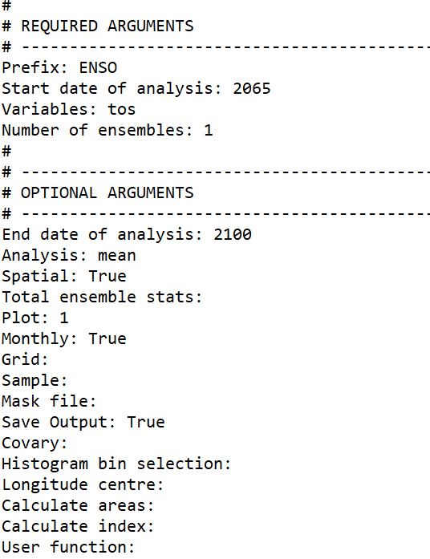
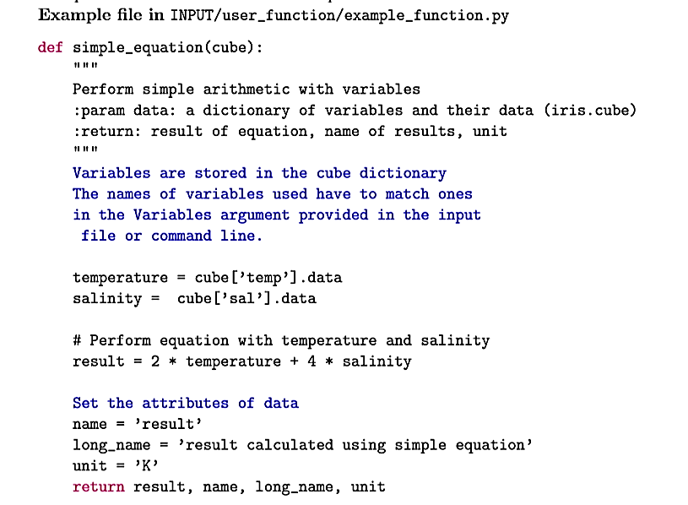
EZclim: Customisability
input.txt
Notes:
The simplicity when using Ezclim also came from isolating the minimum number of requirements needed. We also have the optional arguments which can be set or not set depending on the user preference.
Contains basic prebuilt diagnostics, but aware that users may want to do much more so Ezclim has built in functionality and mechanisms for the user to add whatever analysis they want – given their own Python function and script.

Slide 8


EZclim: Output
EZclim
NetCDF files
Plots – maps, histograms, time series, box plots
On screen
On file
Notes:
EZclim saves the manipulated data in a Netcdf file, which is the common file format used for climate model data.
In response to user feedback, we discovered that users want to be able to receive an immediate view of how the data looks like in the Netcdf file, so EZclim provides the real-time plotting capabilities of maps, histograms, time series and boxplots – which are displayed on screen, but also saved in the output folder.

Slide 9

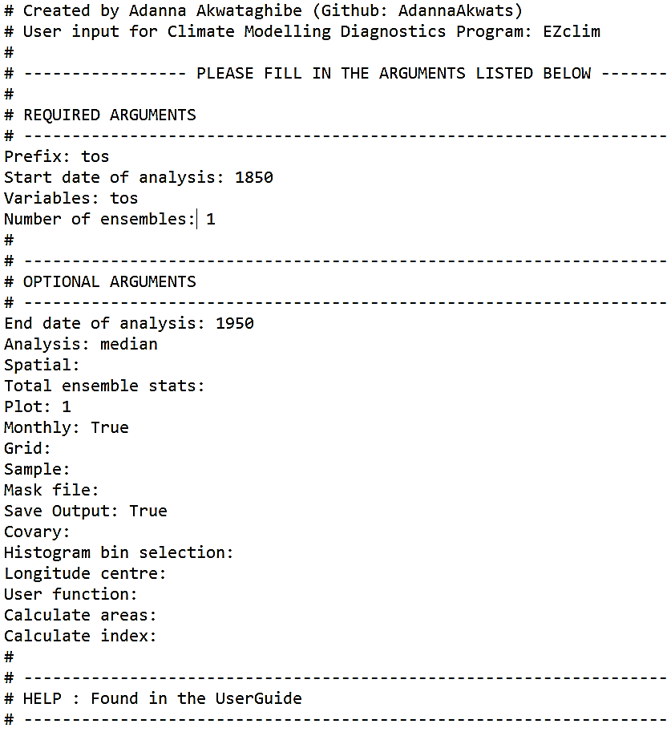
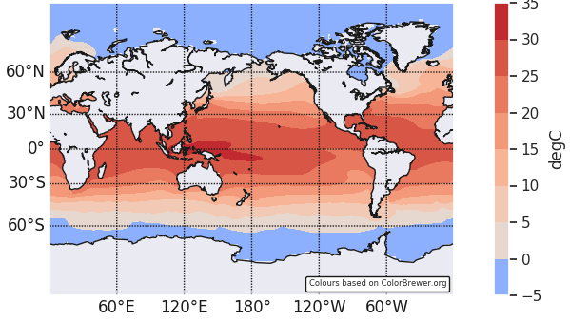
EZclim: Basic functionality
Median SST (1850-1950)
input.txt
Notes:
EZclim contains basic prebuilt diagnostics: median, mean, RMS and Standard deviation. The software can deal with large amount of data. It is also able to deal with ensembles, numerical experiments and show the variability of data.
This is an example of a simple case, where the median of sea surface temperature calculated across 100 years with the input file provided. The temperature is warmer at the equator as you would expect.
--
In an article by James C. McWilliam, Where precision is an issue (e.g., in a climate forecast), only simulation ensembles made across systematically designed model families allow an estimate of the level of relevant irreducible imprecision.
Ensembles – variations between models i.e. having different initial conditions or structure of the models or the model formulations are different
the amount of spread of the model simulations within the ensemble is indicative of the uncertainty (error) or variability of the model

Slide 10
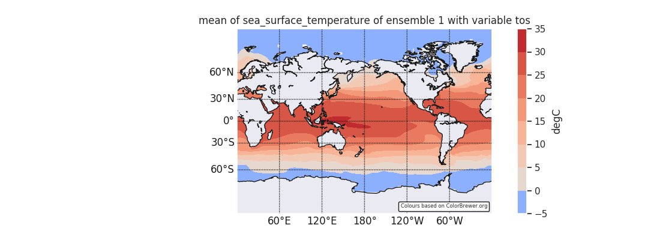
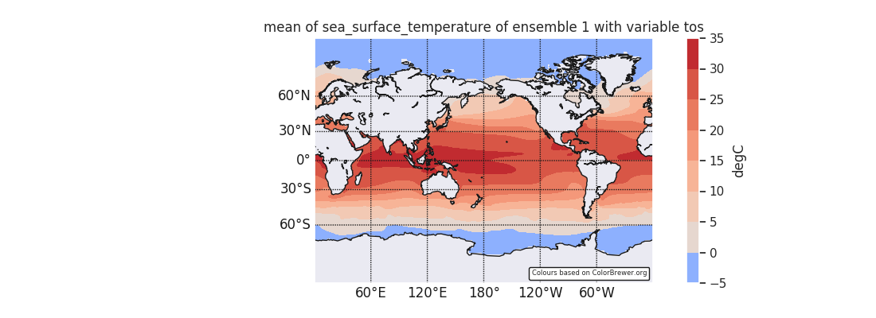
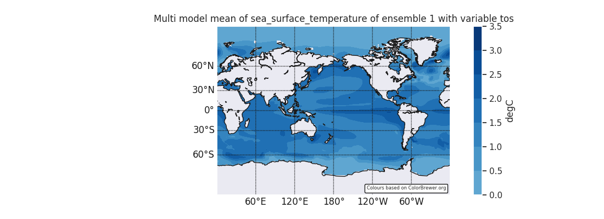
Ezclim handles climate experiments by design
Mean SST (1850-1935)
Mean SST (2015-2100)
(abs)
past
future
Difference Mean SST
change
Notes:
Climate modellers measure climate change by comparing 2 model simulations- or performing multi-model analysis, so we anticipated the user need of being able to handle climate experiments. By design Ezclim can handle 2 experiments at once – so the software ingests a lot of data. In this example, we compute the mean of sea surface temperature in the past and the future and calculate the absolute difference between these means to obtain the change in sea surface temperature.

Slide 11
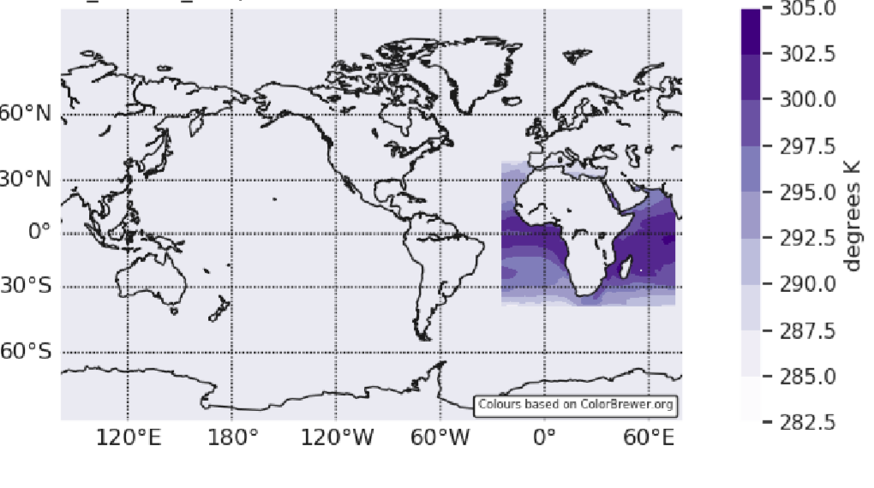
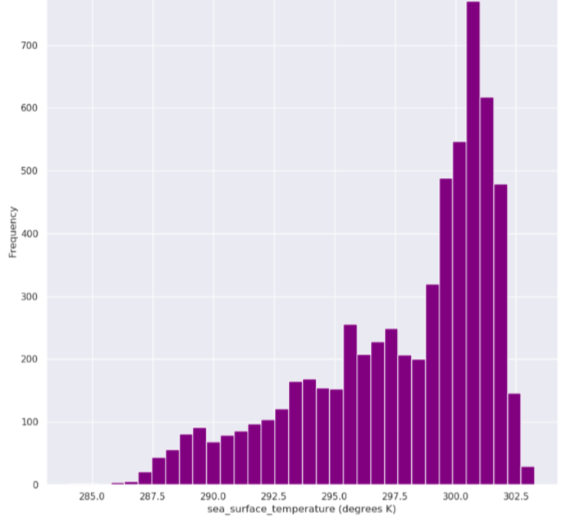
EZclim: Extracting a region using masks
Sea surface temperature at 1980, within masked region
Isolate data within a polygon
Analysis within the selected region
(i.e. histogram)
Notes:
EZclim can also analyse and compute diagnostics within a local region. The data within the region is isolated using a mask file that is given in the user input. The variability in a certain region can also be measured – this is often done by plotting the histogram. Histogram bins can be specified by users: either the number of bins required or even the specific bin edges. Functionality of fixing bin edges is very important for Model inter-comparison work

Slide 12
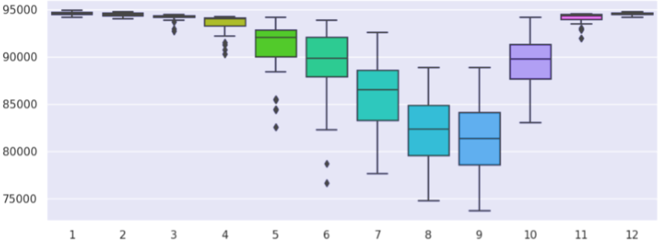
EZclim: Grid manipulation – Sample points and grid points
Air pressure at convective cloud base at grid point (20, 20) between 1979 and 2014
Air pressure at convective cloud base
Months
Notes:
Not only can we perform analysis in global and local regions, we can also analyse a point or series of points.
The sample and grid point refer to the type of interpolation used when obtaining the point value. The sample point uses linear interpolation and grid point uses nearest neighbour interpolation.
This is an example of how we can use the functionality of the grid manipulation to show the seasonal variability of the air pressure as well as the statistics of the randomly selected grid point across 1979-2014.

Slide 13
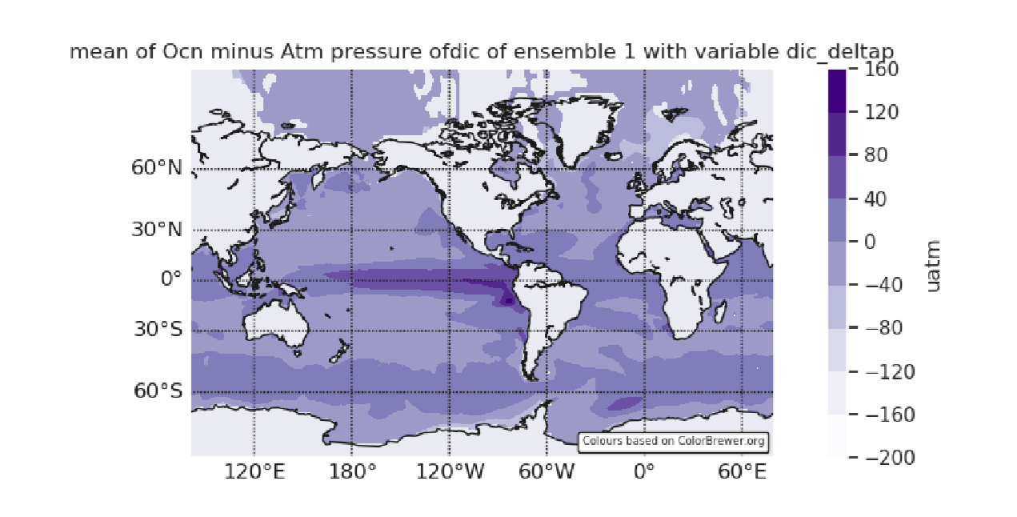
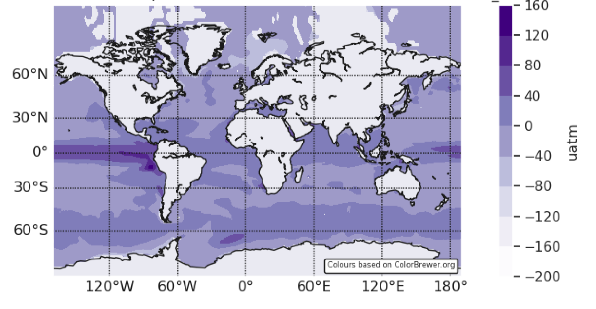
EZclim: Grid manipulation – Rotation
Ocean - atmosphere dissolved inorganic carbon (DIC) gradient (1953 mean from daily outputs)
Centred at 90W
Rotated to 10E
Notes:
When rotating grids and plotting on a latitude/longitude grid, we must be aware of the wrap around problem. That is, the longitudes of earth are between -180 and 180 degrees. However, -180 is next to 180 because earth Is of course, spherical. We had to take this into consideration, when developing the rotation functionality in EZclim. This example shows the grid being rotated from 90 degrees west to 10 degrees east.

Slide 14
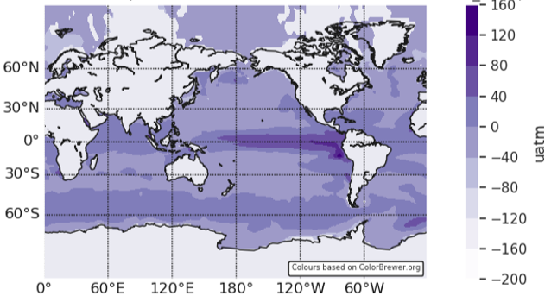
EZclim: Grid manipulation – Regridding
Ocean - atmosphere dissolved inorganic carbon (DIC) gradient (1953 mean from daily outputs)
360 x 200
256 x 128
Important for model-model and model-data inter-comparison
Notes:
EZclim also provides the mechanism to interpolate the grid unto a grid of another model. This can be from finer to coarser grid (or vice versa). This functionality is important for model inter-comparison and model data inter-comparison.

Slide 15





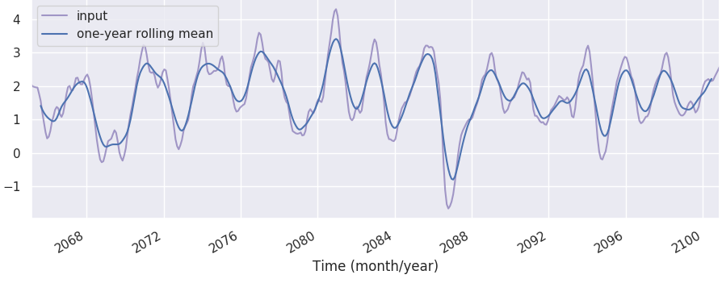
EZclim: Climate indices + shell script interface
ENSO
PDO
NAO
TNO
AAO
AO
(Dundovic Davor)
El-Nino (ENSO) index 2065-2100
Notes:
EZclim provides a recipe for calculating climate indices. We have a shell script with contains the functions, provided to us by an undergraduate in Imperial, Dundovic Davor (from a project he worked on), used to compute these indices using CDO. CDO or climate data operators is a library of C functions designed to do operations with climate model data. Even though these functions are quite fast, they are not user friendly. And they are very specialised and hard for non-experts to use.
EZclim also contains a python script which acts as a wrapper around the bash script, so that the underlying complexity is hidden from the average user. However, by adding this functionality, we have now provided a template for users to inject non-python functions (for example, matlab, R, C, C++...) into our software, using the shell script. Obviously, we cannot create a software that does everything, but this functionality opens a myriad of endless applications and functions that can be written by the user according to their scientific interest.
-
1st run through program: calculate ENSO (El Nino/ Southern oscillation) index
2nd run: plotted the spatial mean of this ENSO index
ENSO: a naturally occurring anomalous state of tropical Pacific coupled ocean-atmosphere conditions - is the primary predictor for global climate disruptions. These can persist over several seasons and thereby produce severe regional effects
Accurate prediction of El Niño–Southern Oscillation (ENSO) at relatively long timescales is propitious to forecasting other climate variables and meteorological disasters

Slide 16

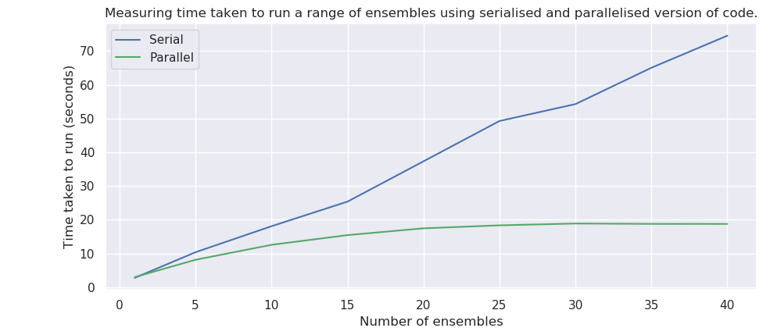
EZclim: Parallelisation, memory and future work
For ‘Extract and Analysis’ classes only
Notes:
Now that we have a highly functional software, there is a need to deal with lots of output (e.g. hourly data) in conjunction with the need for speed.
As a first attempt, we parallelised the Extract and Analysis classes, such that we have one processor per ensemble. We can see that in the serial case, the time taken to run linearly increases with the number of ensembles, however, after parallelisation, the time taken is more dependent on the number of processors available in the system.
Now that the parallelisation infrastructure exists, this can become higher priority in future developments. We would also want to optimise the memory usage of EZclim in the future as well.

Slide 17


Conclusions
Well-structured development platform
Simple interface
Modular, flexible and customisable
Caters to experts and non-experts
EZclim
Notes:
In conclusion, we have developed a well-structured development platform, that has a simple user interface. EZclim is highly customisable as the user can inject any functions they want into the software. Its modularity also enables the software to be flexible, so that new functionality can be easily added by future developers. And finally, we were able to successfully create a software that caters to both experts and non-experts in climate modelling.
I hope you enjoyed the talk. Thank you so much for listening. Any questions?

